Slide 1
Forecasting Zestimate Error for Zillow A Development Project IFN701 Project
Student: Linni QIN (n9632981)
Supervisor: Dr Guido Zuccon

Slide 2
Project Outline
1. Project Context: Real Estate
2. Project Background: Pursuit of Accuracy of Prediction
3. Project Purposes
4. Kaggle Available Data
5. Project Deliverables: Data Analysis Report & A Prediction Model
6. Methodologies for Project Plan and Execution
7. Outcome 1: Data Analysis Report (5 Sections)
8. Outcome 2: A Rational Multiple Linear Regression Model
9. Significance of the Outcomes

Slide 3



Project Context
Zillow: A leading real estate information site in U.S.
Users: real estate agents, mortgage bankers
property buyers, seller and renters
Zestimate: Zillow’s home value prediction model
logerror = log(Zestimate) – log(SalePrice)
Pictures from https://www.google.com.au/search?q=real+estate&source=lnms&tbm=isch&sa=X&ved=0ahUKEwimtIbS6M3VAhUMVbwKHaf-DhwQ_AUICygC&biw=1920&bih=963

Slide 4
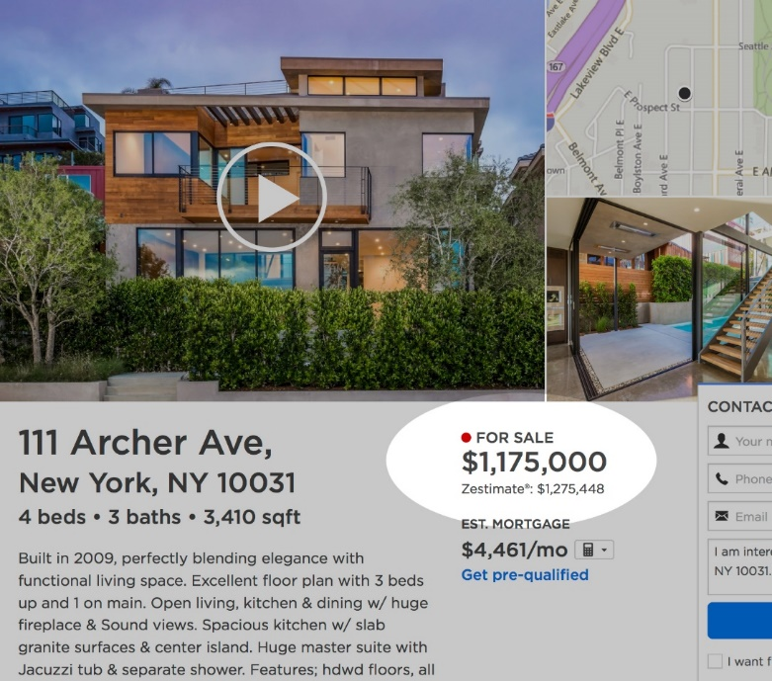
Project Background
Motivation
Currently Median Error of Zestimate ≈ 5% e.g. $1,175,000 * 5% = $58,750
Property buyers, sellers | Overestimate Underestimate | Lost the confidence to use the site of Zillow
Real estate agents, mortgage bankers | Reduce the advertisement budget on Zillow
Zillow | Revenue declined
Anticipated Significance → A trusted platform to monitor home asset with accurate prediction of future home value → Be helpful for decision making during real estate transaction → To enlarge ROI (Return of Investment)
Work with Kaggle.com
Posted a challenge with a prize up to $1.2millions on the data science platform Kaggle to allow global data scientists for competing to identify a better model.
Picture & Data from https://www.kaggle.com/c/zillow-prize-1 & https://www.zillow.com/zestimate/

Slide 5
Project Purp0ses
For IFN701 Project
Taking this opportunity to explore the real world raw data and perform a data science analysis of a dataset
Disclosing the necessary of project management and high-end project methodologies in executing a project
Indicating the essential process for accomplishing a project
For Zillow(By working with Kaggle)
Looking for better prediction model globally to improve Zestimate
Showing the public their ambitions to improve the accuracy of the Zestimate for offering better customer-centred services.
Proving that the performance of Zestimate might be the best so far in the field of data science

Slide 6
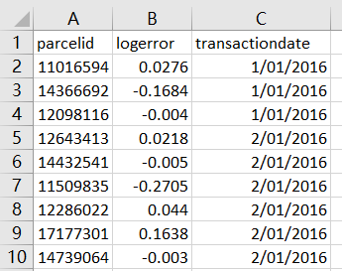
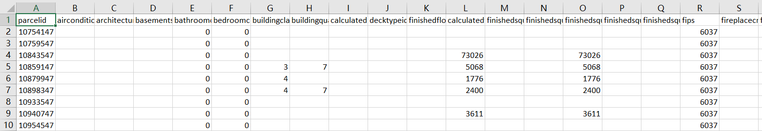
Kaggle Available Data
logerror = log(Zestimate) – log(SalePrice)
Available Data from Kaggle
Training data 2016 (Jan. ~ Dec.): 90k sold parcelids with their logerror and transaction dates
2. Training data 2017 (Available on Oct.2, Jan. ~ Sept.) 80k sold parcelids with their logerror and transaction dates
3. Property data: 3millions of parcelid with their 57 features value in 2016 and 2017 respectively
What I need to do are to:
Merge these two data sets by unique parceled
Explore the relationship between the logerror and 57 variables
Identify a suitable prediction model
Build the function
Predict the value

Slide 7
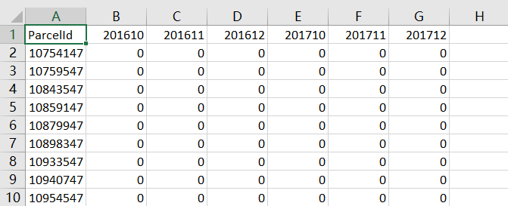
Project Deliverables
A Data Analysis Report
Formats: Rmarkdown/ html 1. Explore the hidden relationships between the logerror and 57 independent variables 2. Identify the right type of prediction model 3. Find out the proper size of variables to fit the model 4. Determine the suitable size of training data and test data, then train the prediction model 5. Evaluate the effectiveness of the model
A Rational Value Prediction Model
It will be able to generate the estimated error data relating to 3millions of properties in California for the last quarter of both 2016 and 2017
logerror = Y, Y = ??????????

Slide 8
Methodologies for Project Plan and Execution
Project Methodologies:
Project Management Approach: Scrum Cynefin: Complex products and complex environment
➔ determine the right model and the fit function for prediction analysis Scrum Advantages:
Transparent plan and visible progress will make the communication effective between supervisor and me.
“To do”, “done” “undo” will enable me to control the progress on the right track.
Sprint retrospect will allow me to adjust progress as an increment.
It will enable the project to be completed on time.
It will help to reduce the risk of submitting failure outcomes.
Programming Tools: R and RStudio
Phase One Data Preparation | Phase Two Data Analysis | Phase Three Results Reflection | Phase Four Results Dissemination
Step 1: Defining problem Step 2: Identifying ideal datasets to answer analysis problems Step 3: Acquiring data Step 4: Cleaning data | Step 5: Exploring data Step 6: Statistical prediction and modelling data | Step 7: Interpreting results | Step8: Communicating and distributing results

Slide 9
MoSCow Prioritised Scope List
In-Scope List | MoSCow | Score
1. Use the data supplied only on Kaggle to predict the error | Must | 2
2. Generate a data analysis report | Should | 23
3. Build a prediction model | Must | 28
4. Predict the error rate and create a csv file for 6 time-point: 201610, 201611, 201612, 201710, 201711, 201712 | Should | 25
5. Submit the outcomes to Kaggle | Could | 2
IN-SCOPE TOTAL SCORE: 80
Out-Scope List | MoSCow | Score
6. Share the code in Kaggle forum and do more contribution in the community | Would | 20

Slide 10
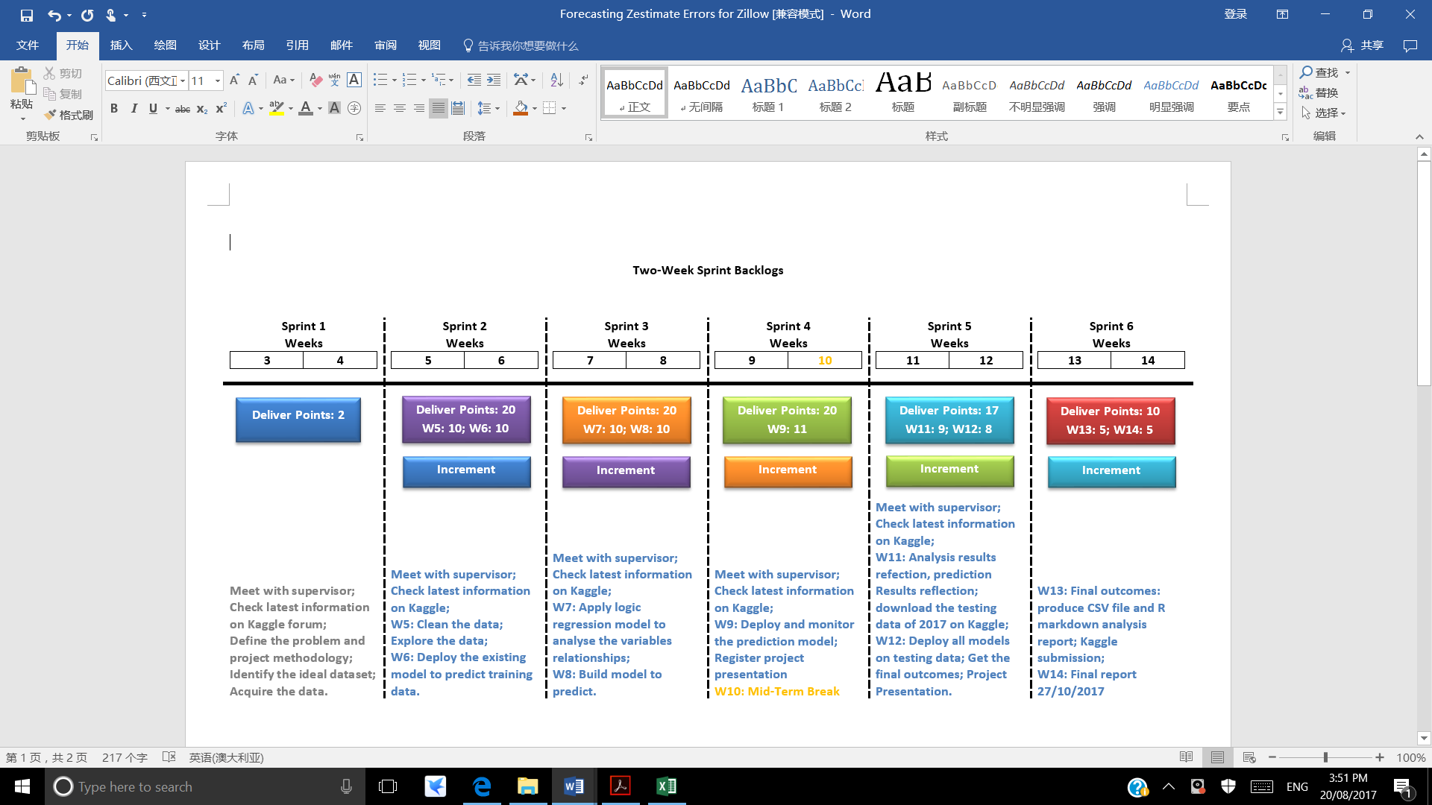
Scrum Tool to Manage Project Process
Phase 4:
Result
Dissemination
Phase 1: Data Preparation
Phase 2: Data Analysis
Phase 3:
Result Reflection

Slide 11
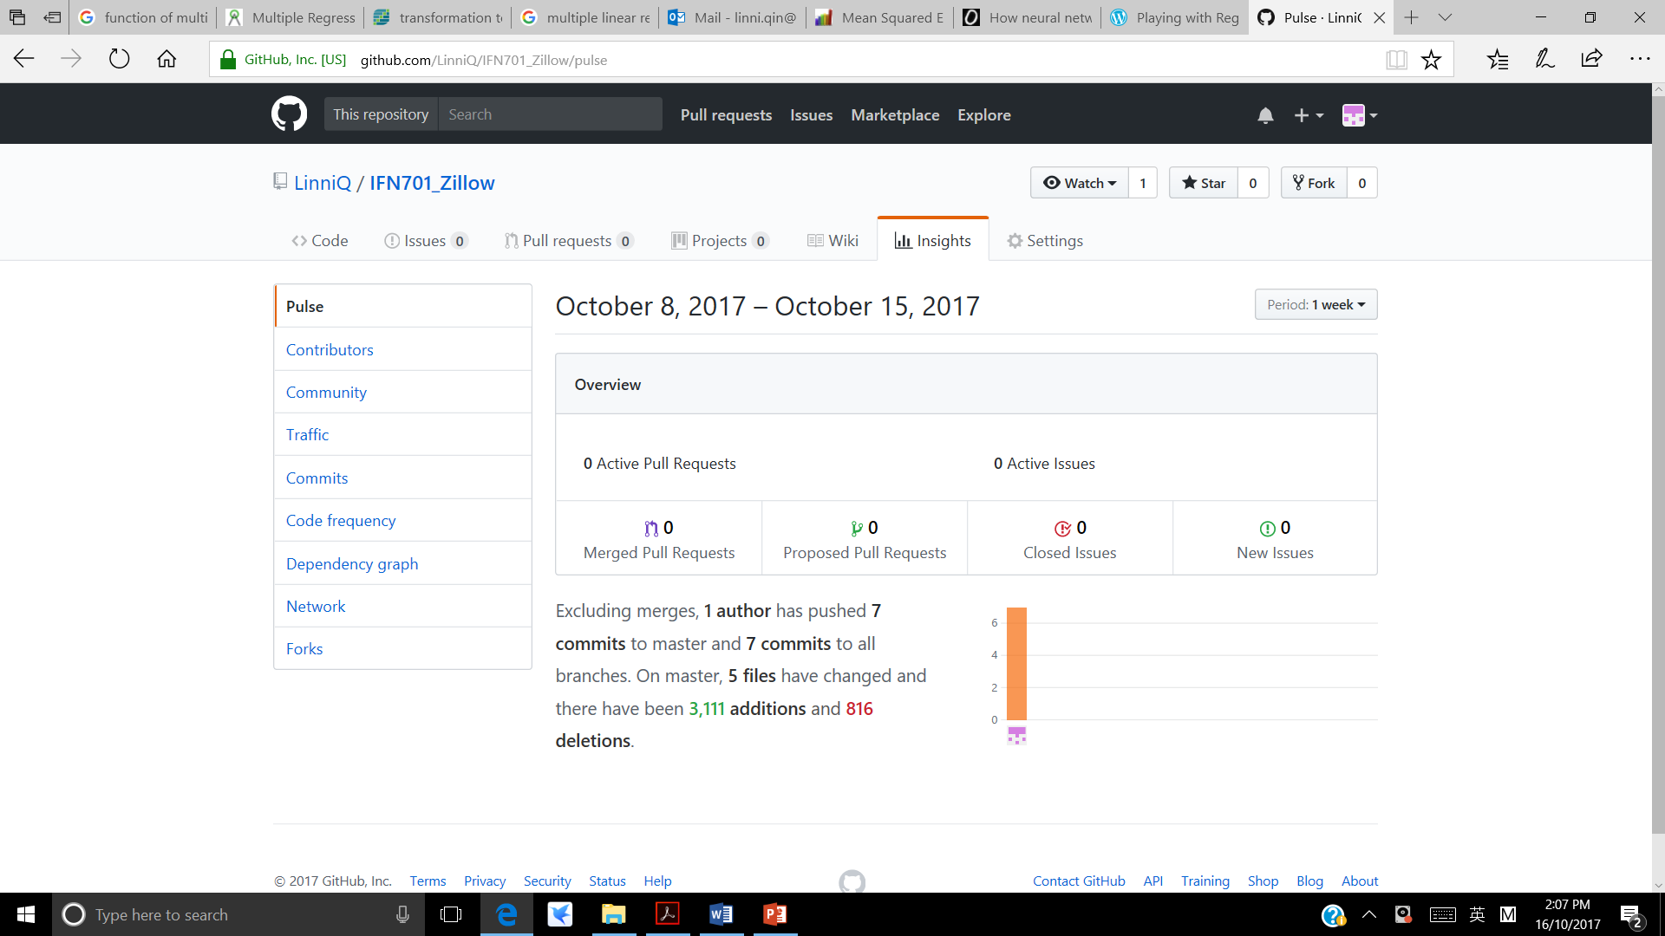
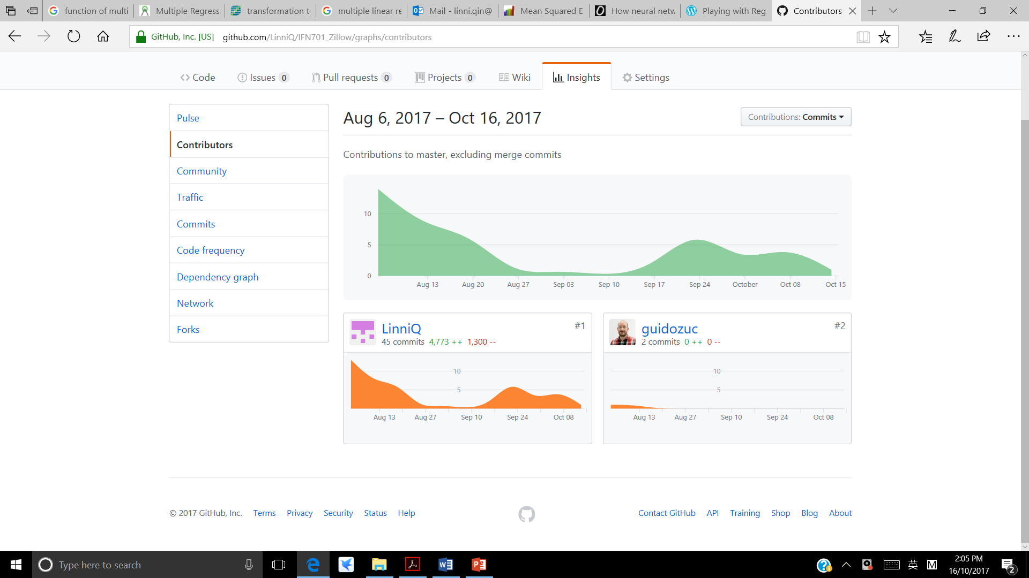
3rd Party Tool to Save Project Process
GitHub
Phase 1:
Data Preparation
Phase 2:
Data Analysis
Phase 3:
Result Reflection
Oct. 16 ~ Oct. 27: Phase 4: Result Dissemination

Slide 12
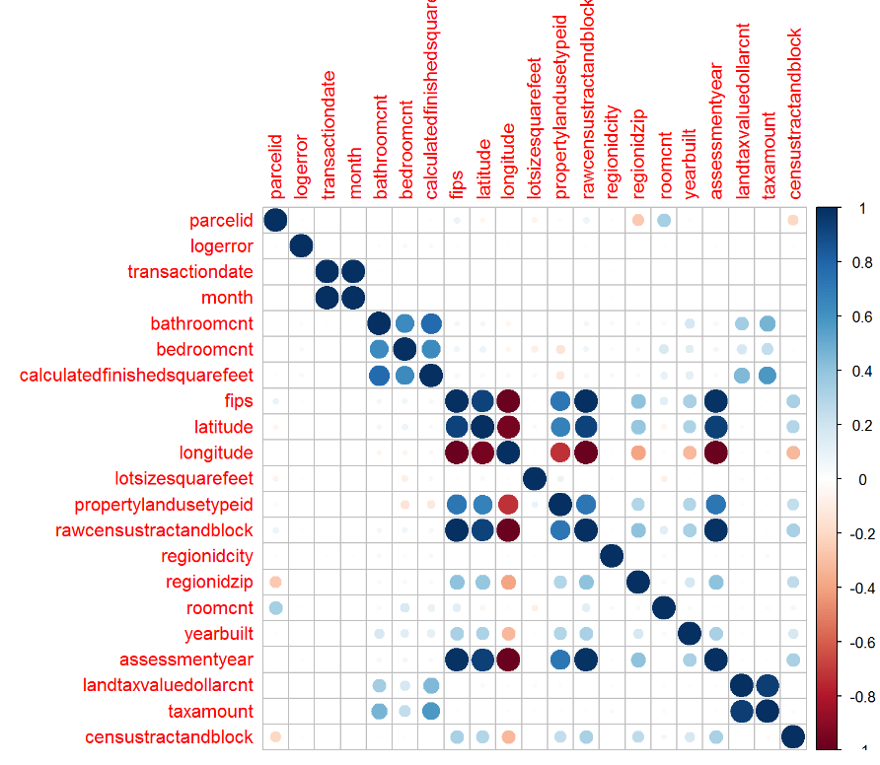
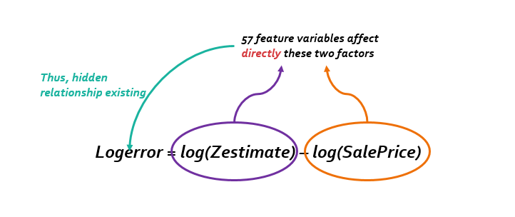
Outcomes 1 Data Analysis Report - Part 1
TO DO | DONE | JUSTIFICATION
Explore the relationship between 57 variables and logerror | No direct correlation existing between and logerror and other variables
Identify the right type of prediction model
Find out the important variables to build a fit model
Determine the suitable size of the training data and test data
Evaluate the effectiveness of the model

Slide 13
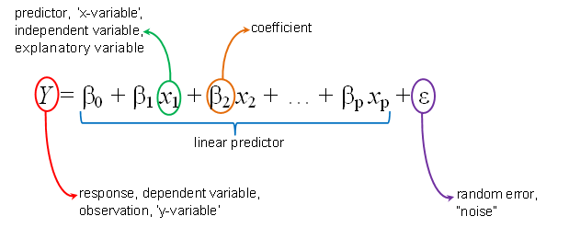
Outcomes 1 Data Analysis Report - Part 2
TO DO | DONE | JUSTIFICATION
Explore the relationship between 57 variables and logerror | No direct correlation existing between and logerror and other variables
Identify the right type of prediction model | Multiple Linear Regression | Able to identify the strength of the effect that the independent variables have on a dependant. It can forecast future value and return a specific value
Find out the important variables to build a fit model
Determine the suitable size of the training data and test data
Evaluate the effectiveness of the model

Slide 14
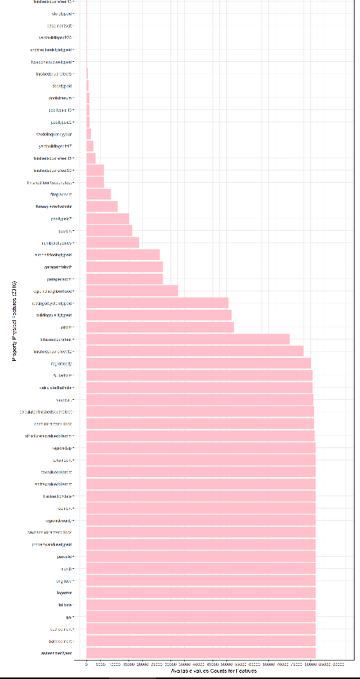
Outcomes 1 Data Analysis Report - Part 3
TO DO | DONE | JUSTIFICATION
Explore the relationship between 57 variables and logerror | No direct correlation existing between and logerror and other variables
Identify the right type of prediction model | Multiple Linear Regression | Able to identify the strength of the effect that the independent variables have on a dependant. It can forecast future value and return a specific value
Find out the proper size of variables to fit the model | 16 variables after filtering the missing, duplicate and non-numeric data
Determine the suitable size of the training data and test data
Evaluate the effectiveness of the model

Slide 15
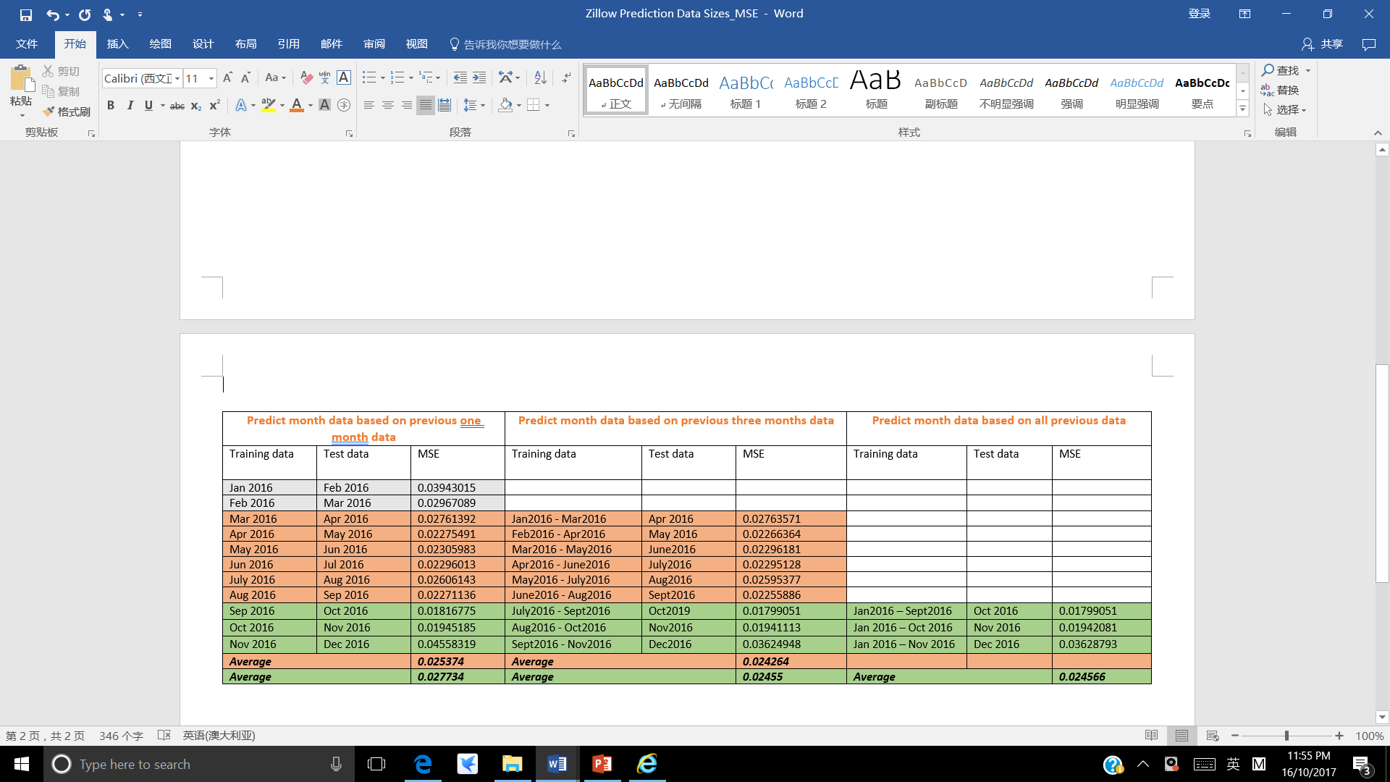
Outcomes 1 Data Analysis Report - Part 4
TO DO | DONE | JUSTIFICATION
Explore the relationship between 57 variables and logerror | No direct correlation existing between and logerror and other variables
Identify the right type of prediction model | Multiple Linear Regression | Able to identify the strength of the effect that the independent variables have on a dependant. It can forecast future value and return a specific value
Find out the proper size of variables to build a fit model | 16 variables after filtering the missing, duplicate and non-numeric data
Determine the suitable size of the training data and test data | Training data size: 1 month, 3months and all existing data Testing data size: next one month | 1. Able to find out the best combination with lowest of Mean Square Error
Evaluate the effectiveness of the model | Mean Square Error | Suggested to be used by Kaggle Able to tell the error distance of the prediction regression line and the actual data points Able to tell the average error of a set of prediction data

Slide 16
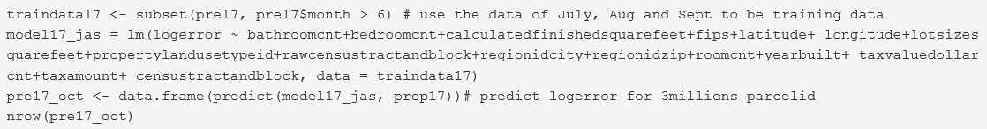
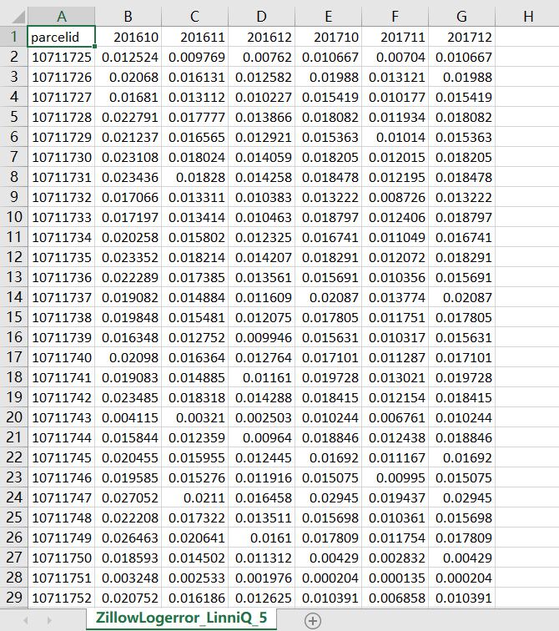
Outcomes 2 A Prediction Model & Predicted Value
A Rational Multiple Linear Regression Prediction Model with 16 independent variables

Slide 17
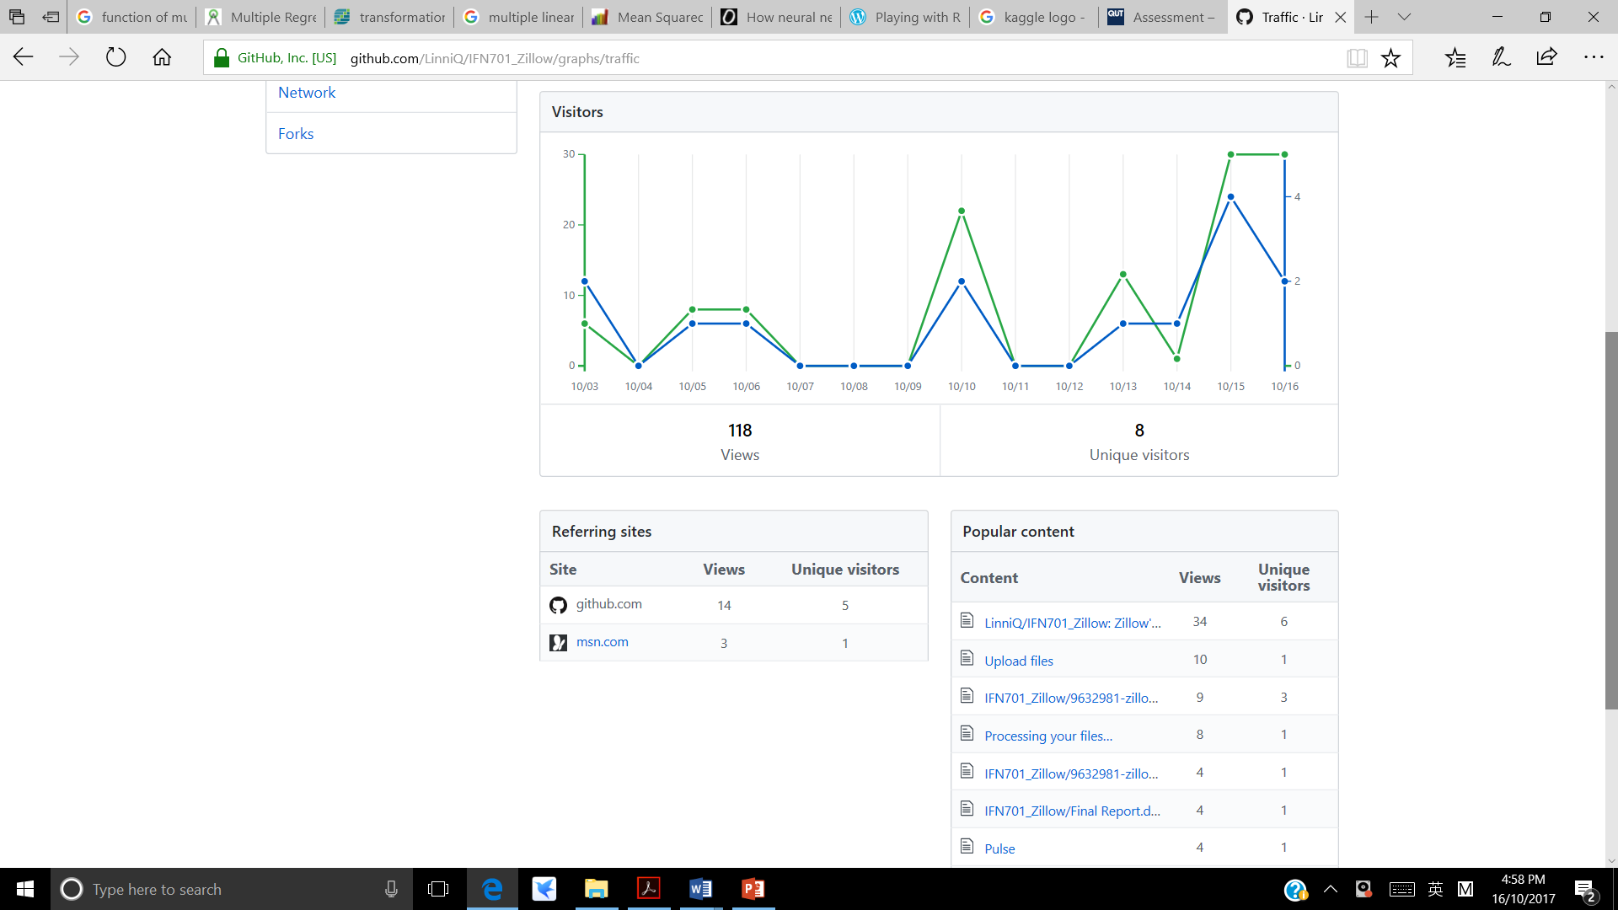
Significance of Data Analysis Report - for GitHub Users

Slide 18
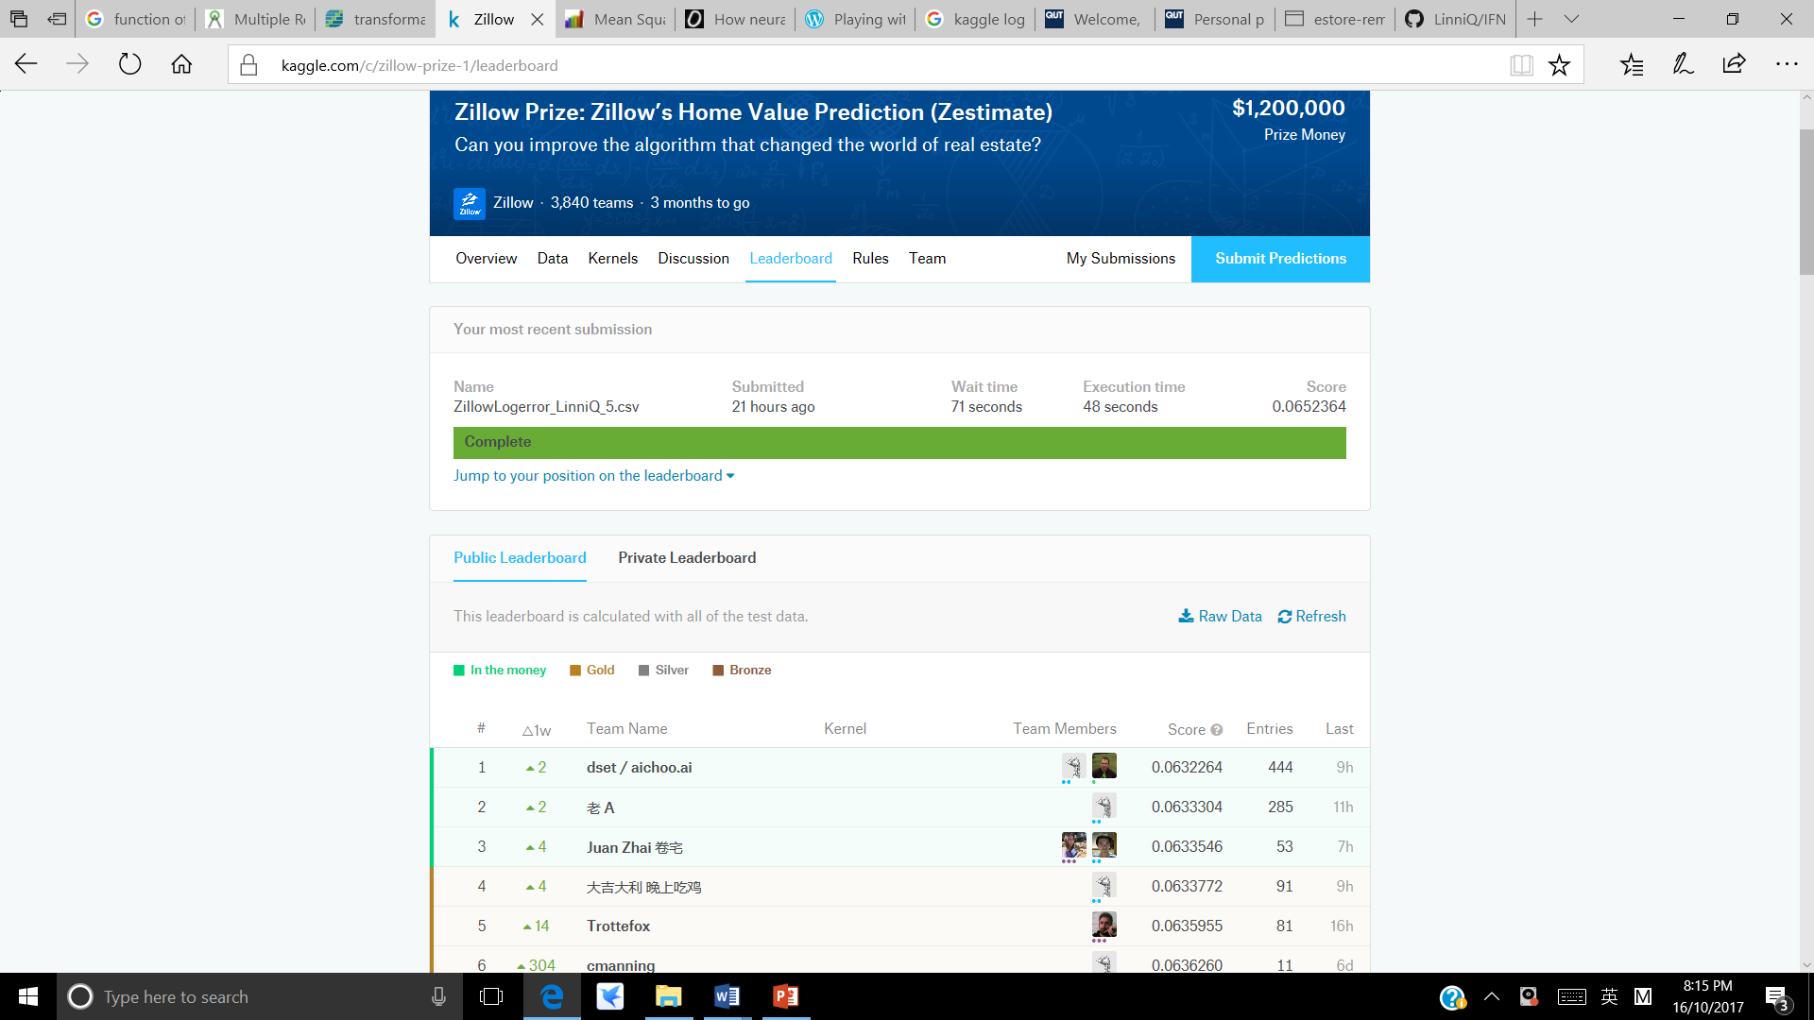
Significance of Prediction Model - for Kaggle and Zillow
Zillow Self-defined MSE
MSE of my model 0n RStudio: 0.02455

Slide 19

The End

